Slide 1
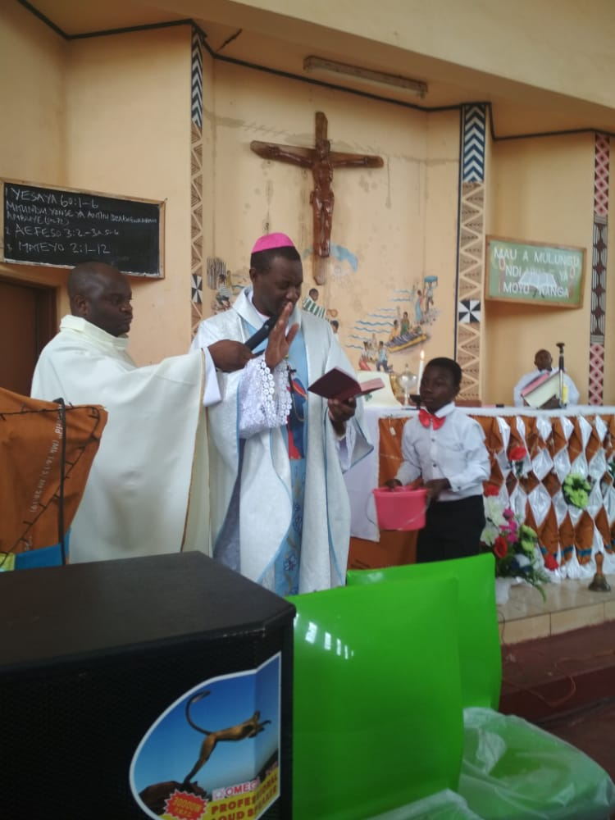
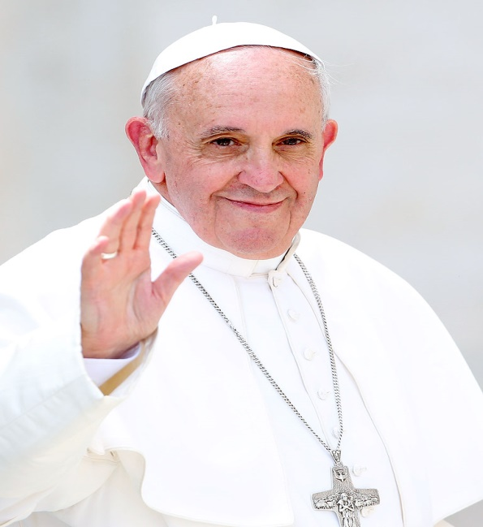
UTHENGA WA APAPA FRANCIS WA PA TSIKU LACHIBALALITSO CHA MPINGO – October,2023
Okonzedwa ndi
PMS office - Diocese of Dedza
5th August, 2023.
MUTU: Mitima iyake ndi moto wa utumiki , mapazi ayende potumikira.
Hearts on fire, feet on the move…
(cf. Lk 24:13-35)

Slide 2
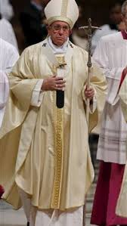
Mawu oyambilira
Apapa chaka chino, asankha mau ogwirizana ndi nkhani ya ophunzira amene anali paulendo wa ku Emmaus.
(cf. Luka 24:13-35)
“Mitima iyake ndi moto wa utumiki, mapazi ayende potumikira”

Slide 3
Mawu oyambilira
Mwachidule zopezeka mu uthenga wa Luka 24:13-35
Ophunzira awiri aja anali atasokonezeka
Ophunzira anali okhumudwa
Ophunzira anakumana ndi Yesu owuka kwa akufa
Ophunzira adakumana ndi mmau ndi mkunyema buledi

Slide 4
Zomwe zinachitika atakumana ndi Ambuye Yesu
“Mitima yao idayakamoto” Kusinthika kwa Ophunzira chifukwa cha mau omwe anamva.
“Maso ao adatsekuka” Adamuzindikira Yesu ndi kukhala ndi Kuutsa mwa iwo mtima okalalikira ena.
“Mapazi ao adanyamuka.”Kuutsa mwa iwo mtima wobwerera ku Yerusalemu ndi kukalalika uthenga woti Yesu waukadi kwa akufa.

Slide 5
Posinkhasinkha za zithunzi zitatuzi, zoonetsa ulendo wa ophunzira ifenso tingathe kukhalanso ndi luntha ndi mtima watsopano woti tilalikire mau a Mulungu m’masiku amakono ano.

Slide 6
Zokambilana kuchokera mu mau oyambilirawa (Luke 24:13-35)
Kodi chinawapangitsa ophunzira aja kuchoka ku Yerusalemu kupita ku Emmaus ndi chani?
Mitima yawo inayaka ndi moto: Kodi chinapangitsa mitima yawo kuyaka mkati mwao?
Maso awo anatsekuka: Mukuganiza kuti chinatseka maso awo ndi chani? Nanga chapangitsa kuti atsekuke ndi chani?
Mapazi awo anayena: Chinapangitsa ophunzira aja kubwerera ku Yerusalemu?
Pali maphunziro ena omwe tingaphunzire kuchokera mu uthenagawu mu gulu / mphakati wathu lino?

Slide 7
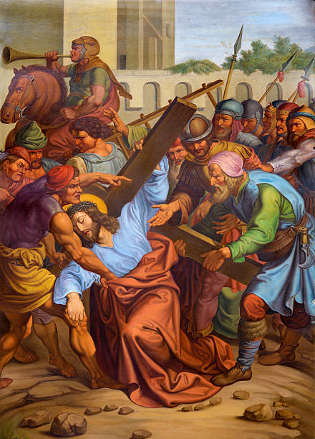
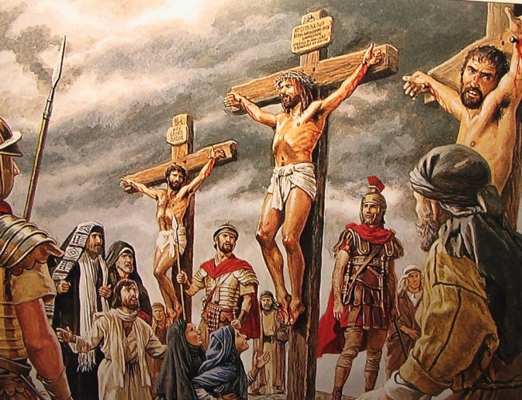
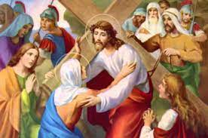
Mitima yathu inayaka moto m’kati mwathu, pamene analikufotokoza Malembo Oyera kwa ife” Pautumiki, mau a Mulungu amaunikira ndi kusintha mitima yathu.
Pa ulendo wochoka ku Yerusalemu kupita ku Emmaus, ophunzira awiri aja anali okhumudwa monga nkhope zao zinalikuwonetsa;
Chifukwa cha imfa ya Yesu Khristu, amene adamkhulupirira (cf.v.17).
Luka: 24: 17 & 21
Komanso poona kulephera kwa Mbuye wao wopachikidwa pamtanda, chiyembekezo chao choti ndiye Mpulumutsi chidatha (cf.v.21).

Slide 8
ZOKAMBILANA ZATHU PA MUTU UMENEWU
1. Moyo wathu wa chikhristu uli ngati ulendo wa ku Emmaus; Kodi nthawi zina sitifowoketsedwa ndi zochitika za mmoyo wathu plondola Ambuye Yesu Khristu?
2. Mukuganiza kuti ndi zinthu ziti zomwe zimatifooketsa pa ulendo wathu wa chikhristu?
3. Ngati ophunzira aja kodi nthawi zina sitimathawa nyengo zomwe timayenera kudutsamo ngakhale kusiya kumene udindo wathu wa utumiki chifukwa tikuna ngati pali chiopsyezo pa moyo wathu?

Slide 9
Popitilira tione zomwe tingaphunzire pa Luka 24: 15 & 25 pamene tikumva kuti:-
Kenaka, pamene analikulankhula ndi kukambirana, ‘’Yesu mwiniwake adawayandikira namayenda nawo limodzi” (v.15). monga adachitira poitana ophunzira oyamba aja, leronso, ali m’kati modandaula, Ambuye awayandikira nayenda nawo limodzi.
Momwemonso, mwachifundo chake, Iye satopa kukhala nafe, ngakhale ndife ofooka, olephera, okayika ndi kutaya mtima komwe kwatisandutsa “opusa ndi osafuna kukhulupirira msanga” (v.25), amuna ndi akazi achikhulupiriro chochepa.

Slide 10
ZOKAMBILANA ZATHU PA MUTU UMENEWU
1. Pamene tabalalika kodi timazindikira kuti Ambuye Yesu alinafe ndipo akuyenda nafe?
2. Kodi pamene takumana ndi mavuto otibalalitsa ndipo chifukwa cha chifundo cha Mulungu tadutsamo; tingachitilire umboni momwe mau a Mulungu atithandizira kudutsa mu nyengo zovutazo?
3. Tingafotokoze zomwe timachita zoonetsa kuti ndife opusa ndi osafuna kukhulupirira msanga pa moyo wathu wa chikhristu ndi pa udindo wathu wa utumiki?
4. Kodi zofooka, zolephera, zokayikitsa ndi zotayitsa mtima zathu zomwe zimatisandutsa “opusa ndi osafuna kukhulupirira msanga” ndi ziti?

Slide 11
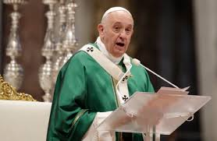
Popitiliza ndi uthengawu Apapa akutiuza kuti:
Masiku ano, monga kale Ambuye amakhalabe pafupi ndi ophunzira ake ndipo amayenda nawo limodzi makamaka panthawi yomwe akhumudwa ndi pamene zinthu ziwoeka kuti sizikuyenda bwino.
Motero, ifenso tisalole kuti titaye chiyembekezo!” (Evangelii Gaudium, 86).
Ambuye ndi aakulu kuposa mavuto athu onse.
Amatithandiza pamene takumana ndi mavuto pa ntchito yofalitsa Mthenga wa wabwino pa dziko lonse lapansi.
Amatithandiza chifukwa utumikiwu ndi wa Ambuye mwini.
Lero ife sitili kanthu kupatula kuti “ndife antchito osayenera kulandira kanthu. Timangochita zimene timayenera kuchita.” Luka 17:10

Slide 12
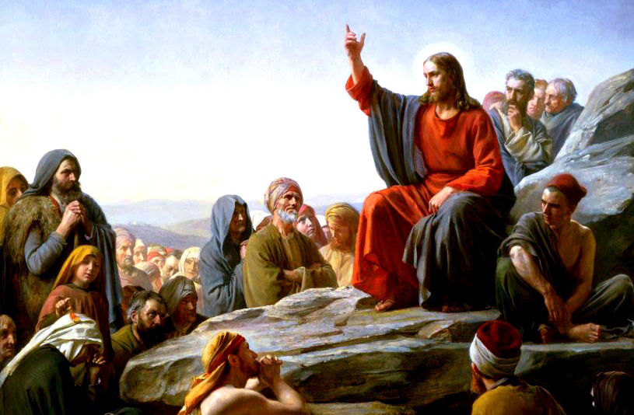
ZOKAMBILANA ZATHU PA MUTU UMENEWU
Pamene tikuziona kuti tabalalika, tikusowa kulimbikidwa komanso tili ndi mantha, tuganiza kuti tiyenera kudalira ndani?
Tingagawane zotani pamene timalowa kuti chiyembekezo chathu chilandidwe mwa ife komanso tingachiteteze bwanji?
Mukuganiza kuti tingatani pamene tazindikira kuperewera kwathu mu utumiki wathu ngati akhristu? (Lk 17:10)

Slide 13
Apapa mu uthenga wawo akupitiliza kuti:-
Okondeka abale, Ambuye ouka kwa akufa ali nanu nthawi zonse.
Amaona kukoma mtima ndiponso kupirira kwanu pamene mukugwira ntchito yofalitsa mau a Mulungu ku maiko akutali.
Ngakhale kuti masiku onse sakhala abata ndi mtendere, koma tisayiwale mau a Ambuye athu Yesu Khristu kwa abwenzi ake asanapachikidwe pamtanda: “Ndakuuzani zimenezi kuti mukhale nawo mtendere pakukhulupirira Ine.
M’dziko lapansi mudzaona masautso, koma limbikani, Ine ndagonjetsa mphamvu zoipa za dziko lapansi”. (Yohane 16:33).
Ndikulakalaka kukhala pafupi ndi Khristu, kwa amuna ndi akazi amishoni m’dziko lonse lapansi, makamaka kwa iwo amene akuvutika ndi kupirira m’mavuto osiyanasiyana.

Slide 14
1. “M’dziko lapansi mudzaona masautso / zovuta.” Tiyeni tikambilane masautso / zovuta zomwe tikumana nazo ngati atumiki ake a Mulungu mmadlea mwatthu?
2. “Limbikani musaope” Tingatchuleko ena mwa anthu omwe anaonetsa kulimbika pa chikhristu chawo ndi pa utumiki wao ku dela lathu kapena kwina?
3. “Ine ndagonjetsa mphamvu zoipa za dziko lapansi” Mukuganiza kuti ndi chifukwa chani Ambuye Yesu anagonjetsa dziko lapansi mkumafunanso ife kuti tidzipereke ku ntchito yofalitsa uthenga wabwino?

Slide 15
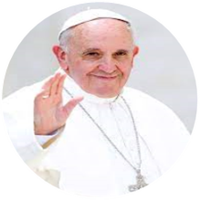
Apapa akupitiliza ndi uthenga wao polimbikitsa aliyense kuti:
Atamvetsera zolankhula za ophunzira awiri aja amene anali paulendo wopita ku Emmaus, Yesu wouka kwa akufa, adayamba kuwatanthauzira zimene zidalembedwa za Iye “kuyambira m’mabuku a Mose mpaka mabuku a aneneri onse, m’Malembo onse” (Luka 24:27).
Mitima ya ophunzira aja idalumpha ndi chimwemwe, pamene adayamba kufunsana kuti: “Zoonadi ndithu, mitima yathu inachita kuti phwii muja amalankhula nafe panjira paja nkumatitanthauzira malembo”. Luka 24:32
Yesu mwini wake ndi Mau amoyo, Iye amene angachititse mitima yatheu kuyaka moto pamene akuyiunikira ndi kuyisintha.

Slide 16
ZOKAMBILANA ZATHU PA MUTU UMENEWU
1. “kuyambira pa mabuku a Mose mpaka mabuku a aneneri onse, Tchulani mau / malemba mchipangano chakale amene amalosela za utumiki wa Ambuye Yesu?
2. “Mitima ya ophunzira aja idalumpha ndi chimwemwe…, mungagawireko anzanu mmene mmamvera mukamva mau a Mulungu, kapena mukakumana ndi Ambuye Yesu pachipembedzo?
3. Mukuganiza kuti Ambuye Yesu amene ndi mau opatsa moyo amayatsa mitima yathu ndi kuyisintha?

Slide 17
Apapa akumalizitsa mfundo yoyambayi ponena kuti:
Mwa njira imeneyi, titha kumvetsa bwino zomwe adanena Yeronimo Woyera kuti, “kusadziwa Malembo Oyera nkusadziwa Khristu”
“Ambuye akadapanda kutisonyeza, nkosatheka kumvetsa mozama Malembo Oyera, utumiki wa Yesu mu Mpingo ukadakhala wosadziwika” (Aperni tillis 1).
Izi zitanthauza kuti nkofunika kudziwa Malembo Oyera pa moyo wathu ife akhristu, kuti tifalitse Khristu ndi Mthenga Wabwino.
Ngati sichoncho, mukuphunzitsa chiyani kwa anzanu kupatula maganizo ndi zolinga zanu?
Mtima wozizira sungayatse moto m’mitima ya anthu ena!

Slide 18
ZOKAMBILANA ZATHU PA MUTU UMENEWU
Kodi kufunika koti ife atumiki a Mulungu tidziwe malemba oyera (Bible) mozama mkotani?
Tikuona ngati timalidziwa mokwanila malemba oyera (Bible) kuti titha kukhala Atumiki a Mulungu kapena amishoni?
“Mtima wozizira sungayatse moto m’mitima ya anthu ena. Tingatani kuti mitima yathu iyake kuti ithe kuyatsanso moto wa utumiki m’mitima ya anthu ena?

Slide 19
2. Maso athu, “adatsekuka ndipo tidamzindikira pamene ankanyema buledi. Yesu wokhala mu Ukaristia, ndiye kasupe ndi chimake cha utumiki.
Chifukwa choti mitima yao idayaka, ophunzira adapempha Ambuye kuti akhale nawo
Pamene anali pa malo odyera, maso a ophunzira aja adatsekuka ndipo adamzindikira pamene ankanyema buledi.
Maso ao adatsekuka chifukwa cha zomwe Yesu adachita: atatenga buledi di mudalitsa namunyema ndipo adawapatsa.(Luka 24:31).
Pano ndi pamene tingathe kuzindikira thime la chikhulupiriro chathu.

Slide 20
2. Maso athu, “adatsekuka ndipo tidamzindikira pamene ankanyema buledi. Yesu wokhala mu Ukaristia, ndiye kasupe ndi chimake cha utumiki.
Khristu, amene amanyema buledi, tsopano wasanduka buledi wonyemedwa, wogawidwa kwa ophunzira ake ndi kudyedwa ndi ophunzirawo.
Yesu sakuwonekanso chifukwa walowa m’mitima ya ophunzira, pofuna kuti iyakireyakire ndi moto.
Ndipo izi zikuwachititsa kuti anyamuke pompopompo ulendo wokagawana ndi aliyense za kukumana kwao ndi Ambuye ouka
kwa akufa
.
Motero, wamishoni aliyense, akuyenera kusanduka, monga Yesu, ndipo mwa iye, kudzera mu ntchito za Mzimu Woyera asanduke wonyema buledi ndiponso amene akunyemedwa chifukwa cha dziko lonse lapansi.

Slide 21
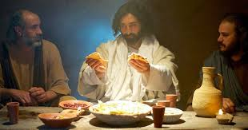
2. Kunyema Bread ndi kudya: Tikalandira ukalistia, kodi timazindikira ndi Ambuye Yesu yemwe wanyemedwa ndi kukhala chakudya cholimbitsa mizimu yathu?
1. Ngati mtumiki wa Yesu kodi ndimayesetsa bwanji kudzipereka ngati Ambuye Yesu posamalira mizimu ya anzathu?
3. Kodi timazindikira kuti Ambuye amatha kusowa mmoyo wathu wa uzimu?

Slide 22
Apapa akuti kunyema buledi nkugawana ndi anthu anjala ndi udindo wathu.
1. Nanji kunyema Ukaristia, umene uli Khristu, ndi ntchito yopambana popeza Ukaristia ndi kasupe komanso chimake cha moyo wautumiki mu Mpingo.
3. Monga adanenera Papa Benedikito wa XVI: “sitingathe kudzisungira tokha chikondi chimene timakondwerera mu Ukaristia.
2. Potengera momwe zinthu ziliri Ukaristia umayenera kugawidwa kwa aliyense amene ndi okonzeka kutumikira limodzi ndi mpingo moyenera.

Slide 23
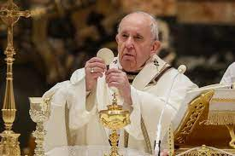
Apapa akuti lero / zaka zino chomwe dziko lonse lapansi lisowa ndi chikondi cha Mulungu, kukumana ndi Khristu ndi kumkhulupirira.
Pachifukwa cha chimenechi Ukaristia si kasupe ndi chimake cha moyo wa Mpingo okha ayi.
Ukalistia ndi kasupe komanso chimake cha utumiki wa Khristu.
Choncho mpingo wotsamira pa Ukaristia ndi Mpingo wautumiki”. (Sacramentum Caritus, 84)

Slide 24
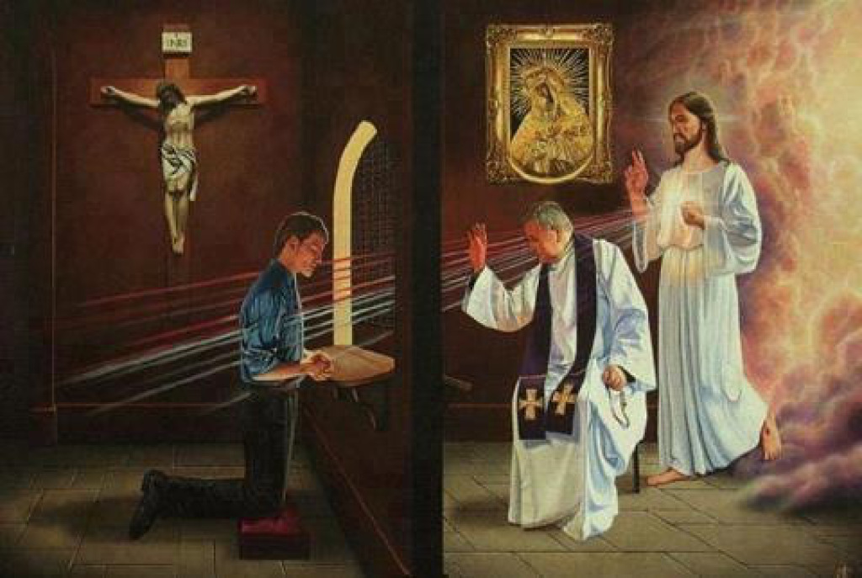
Tikambilane zifukwa zomwe anthu ena salandilira sacrament la Ukalistia?
Nchifukwa chiyani ena amalandira ukalistia mosakonzekera bwino polandira sacrament la kulapa?
Pa utumiki wathu tingatani kuti tithandize anthu ambiri kulandira ukalistia moyenera komanso mwa ulemu kuti mitima iyake ndi moto wa utumiki?

Slide 25
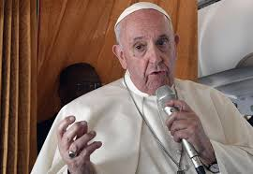
Pofuna kuti tibereke zipatso, tiyenera kuphathana ndi Yesu Khristu. (cf. Yohane 15:4-9).
Umodzi umenewu umakwaniritsidwa kudzera m’mapemphero a tsiku ndi tsiku, makamaka kudzera m’kupembedza Ukaristia.
Pokulitsa mwachikondi umodzi wathu ndi Khristu, wophunzira amasanduka wobisika pamene akugwira ntchito.
Mitima yathu nthawi zonse izilakalaka kukhala ndi Yesu, nkumabwereza pempho la ophunzira aja ku Emmaus kuti; “Mukhale nafe Ambuye (cf.Luka 24:29).
APAPA AKUPITILIZA MU UTHENGA WAO KUTI:

Slide 26
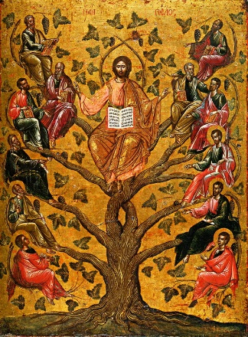
(Tiwerenge Yohane15: 4-9)
Tikambilane mafunso otsatilawa
1. Tikambirane kufunika koti ife ngati atumiki tidziphathana kwenikweni ndi Yesu Khristu mphinzitsi wathu?
2. Tikambilane njira zomwe zingatithandizere kuti tiphathane ndi Mulungu nthawi zonse?
3. Titchule zinthu zomwe zimatipangitsa kulekana ndi Mulungu?

Slide 27
3.Mapazi athu adanyamuka ndi chimwemwe chokauza anthu ena za Khristu wouka kwa akufa. Mpingo wampahmvu umene uli wokonzeka nthawi zonse kukatumikira ku madera ena.
Pamene maso awo adatsekuka ndikuzindikira Yesu “pamene analikunyema buledi”, ophunzira aja adanyamuka nabwerera ku Yerusalemu”
(cf Luka 24:33).
Izi zikukusonyeza kuti chimwemwe cha mau a Yesu chinali chitadzaza mitima yao.
Limodzi ndi Yesu Khristu, chimwemwe chomabadwa ndi kumakulirakulira mmoyo wa okhulupilira” (Evangelii Gaudium, 1).
Kunyamuka mofulumira, kuti akagawane ndi anzao chimwemwe choti akumana ndi Ambuye.

Slide 28
Palibe munthu amene angakumane ndi Yesu popanda kuyatsidwa ndi moto komanso mpahmvu zofuna kuuza aliyense za Iye.
Motero, anthu oyenera kutumikira ndi anthu amene akumana ndi Yesu m’Malembo Oyera ndi mu Ukaristia.
Iwowa amanyamula Khristu mmitima yao komanso kuwala kwake pa nkhope yawo.
Iwowa angathe kuchitira umboni moyo umene sudzafa konse ngakhale zitavuta chotani ndiponso m’nthawi yamasautso.

Slide 29
Mafunso okambirana
1. “Maso awo adatsekuka nazindikira Yesu” Kodi ndi nthawi ziti pomwe nafenso timamuzindikira Yesu m’moyo wathu?
2. Ophunzira aja mofulumira adanyamuka nabwerera ku Yerusalemu” (cf. Lk 24:33): Ndi chukwa chiyani Ophunzira ananyamuka mofulumira kumabwerera ku Yerusalemu?
3. Tikhale atumiki otani mu Mpingo kuti tikwaniritse ntchito yathu mwa chimwemwe?

Slide 30
Chithunzi cha “mapazi oyenda” chikutikumbutsa za kufunikira kwa utumiki wathu.
Utumiki woperekedwa ku Mpingo ndi Ambuye Yesu kuti tikalalikire kwa munthu aliyense mpaka kumalekezero kwa dziko lapansi.
Masiku ano, kuposa kale, mtundu wa anthu wavulala ndi kusowa kwa chilungamo, kugawikana ndi nkhondo.
Mtundu wa anthu ukusowa kumva Mthenga Wabwino wamtendere ndi chipulumutso mwa Khristu.

Slide 31
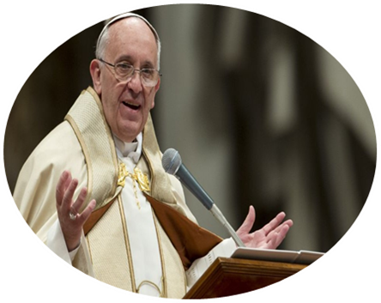
Apapa akubwereza kuti, “aliyense ali ndi ufulu wolandira Mthenga Wabwino.
Choncho akhristu ali ndi ntchito ndiponso udindo wolalikira mau a Mulungu mosapatula aliyense, wosati mokakamiza koma mogawana chimwemwe ndi moyo watsopano ndiposo wogawana zabwino”
(Evangelii Gaudium, 14).
Kutumikira ndiye cholinga chathu chachikulu mpingo, choncho aliyense payekhapayekha komanso ngati gulu akuyenera kutumikira, chifukwa “Utumiki wofikira ena ndiye chinthu chachikulu mu Mpingo”.

Slide 32
Mafunso okambirana
Chithunzi cha “mapazi ayende” chikutikumbutsa chani pa moyo wathu wa chikhristu?
Nkofunikira bwanji kwa ife kuti tinyamuke ndi kukafikira ena ngati atumiki a yesu khristu?
Ndi chifukwa chiyani lero dziko lapansi likufunika kwambiri kulandira uthenga wabwino wa chipulumutso ndi wa mtendere?
Ndani amene akuyenera kugwira ntchito imeneyi yofalitsa uthenga wabwino mpaka ku malekezero a dziko la pansi?

Slide 33
Apapa popitiliza uthenga wao akuti:
Monga Paulo Woyera akutsimikizira, chikondi cha Khristu ndicho chimatiwongolera mokakamiza popeza kuti tikudziwa mosakayika konse kuti munthu mmodzi adafera anthu onse, ndiye kuti pamenepo onse adafa.
Chikondi chimenechi chili m’magawo awiri: chikondi cha Khristu kwa ife chimene chimatiitana, chimatilimbikitsa ndi kuutsa mwa ife chikondi chokonda Iye.
Ndipo kwa mamembala ake onse, amapatsidwa udindo wolalikira Mthenga Wabwino wa Khristu ndi chikhulupiriro chakuti Iye adafera anthu onse pofuna kuti amene ali moyo, asakhale moyo chifukwa cha iwo eni koma chifukwa cha Iye amene adawafera ndipo adauka kwa akufa” (v.15).

Slide 34
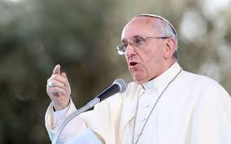
Ife tonse tingathe kuchitapo kanthu pa utumiki umenewu: pakuchita mapemphero ndi kugwira ntchito zosiyanasiyana, pakuchita zopereka, pakupereka masautso athu ndiponso pakuchitira umboni.
Bungwe la Utumiki wa Apapa (Pontifical Mission Societies-(PMS) ndi njira yokhayo yopititsira patsogolo mgwirizano wa atumiki mokhudzana ndi moyo wauzimu ndiponso zosowa za anthu.
Chifukwa cha chimenechi, ndalama zosonkhetsedwa pasiku la Chibalalitso cha Mpingo zimapita ku thumba la bungwe la PMS kuti zithandizire pa kufalitsa chikhulupiriro.

Slide 35
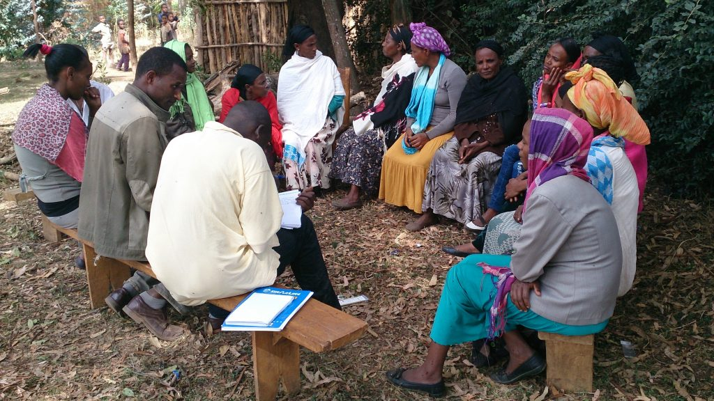
Mafunso okambilana
1. Tifotokoze njira ziwiri zoonetsera chikondi monga akufotokozera Paulo Woyera (2 Cor 5:14).
2. Monga akufotokozerera Paulo Woyera ndi chifukwa chani ife akhristu tikuyenera ktengera utumiki ofalitsa uthenga wabwino kwa anthu onse?
3. Kodi ife akhristu tinga uthandize bwanji mpingo mu utumiki wake potengera malangizo a Paulo Woyera?

Slide 36
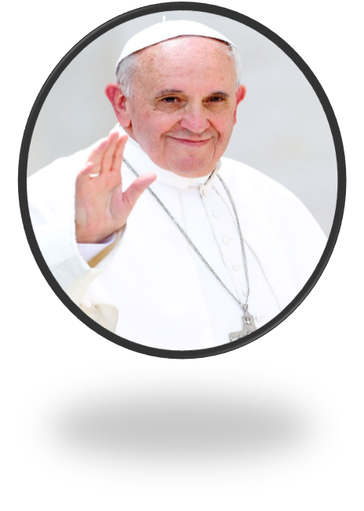
Motero, utumiki wa Mpingo utanthauza kuti pakhale mgwirizano wamphamvu pakati pa mamembala ake ndi kwa anthu osiyanasiyana.
Ichi ndiye cholinga chachikulu pa ulendo wa sinodi imene Mpingo ukuchita, motsogozedwa ndi mau awa: kugwirizana, kutengapo mbali ndiponso kutumikira.
Ulendo uemnewu sukutanthauza kuti Mpingo ukubwerera m’mbuyo kapena ukufuna kudziwa zofuna ndi zolinga za anthu.

Slide 37
M’malo mwake ndi ndondomeko ya kunyamuka monga adachitira ophunzira a ku Emmaus aja, amene ankamvetsera kwa Ambuye.
Chifukwa Iye nthawi zonse amabwera pakati pathu kuti atifotkozere tathauzo la Malembo Oyera
Amanyema buledi chifukwa cha ife pofuna kuti, ndi mphamvu za Mzimu Woyera tipitirize utumiki wake pa dziko lapansi.

Slide 38
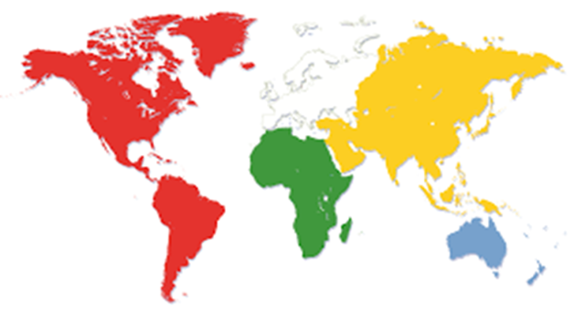
Mafunso okambilana
1. Ndi chifukwa chiyani mgwirizano potumikira mpingo ndi ofunika kwambiri pakati pa atumiki ampingo ndi pa magwo onse a mpingo? (Local and Universal Church)
2. Pali mgwirizano otani udindo wa utumiki omwe akhristu ali nawo ndi ulendo wa synod mpingo wathu ukukondwerera zaka ziwirizi?
3. Monga Ophunzira awiri aja tikuona kuti mkofunika bwanji kuti tidzimvetsera Ambuye owuka kwa akufa?

Slide 39
Monga ophunzira awiri aja a ku Emmaus adafotokozera anthu ena zomwe zidachitika pa njira paja (cf. Luka 24:35), nafenso tidzayenera kufalitsa mwachimwemwe za Khristu Ambuye, moyo wake, kusauka kwake, imfa ndi kuuka kwake ndiponso zodabwitsa zomwe chikondi chake chakwaniritsa m’miyoyo yathu.
Motero, tiyeni tinyamuke, mounikiridwa ndi kukumana kwathu ndi Ambuye wouka kwa akufa motsogozedwa ndi Mzimu Woyera.

Slide 40
Tiyeni tinyamuke ndi mitima yoyaka moto, ndi maso athu otsekuka ndiponso ndi mapazi athu amene akuyenda.
Tiyeni tinyamuke kuti tikayatse moto ndi mau a Mulungu, pofuna kutsekula maso a anzathu kuti azindikire Yesu wokhala mu Ukaristia, ndiponso kuitana wina aliyense kuti tiyende naye limodzi pa njira yamtendere ndi chipulumutso chomwe Mulungu, mwa Yesu Khristu, adapatsa mtundu wonse wa anthu.

Slide 41
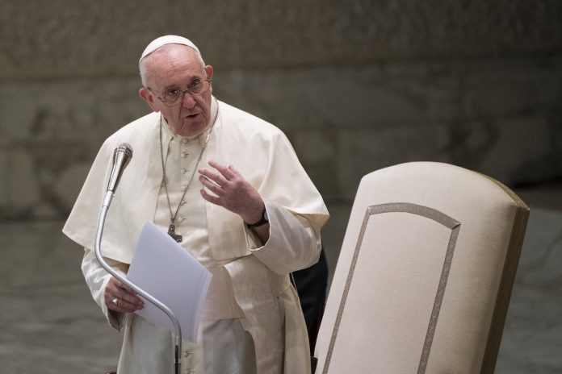
Mafunso okambilana
Ifenso monga ophunzira awiri aja anawauza anzawo zomwe zinachitika pa ulendo wao uja, ife tingafotokozere anzathu mfundo zotani zokhudza Ambuye Yesu owuka kwa akufa?
Kodi ndi zinthu ziti zomwe zinawakankha ophunzira aja kukhala ndi mtima wa utumiki ndi kubwerera ku Yerusalemu kukalalika uthenga wa Yesu?
Potsiliza mu uthenga wa Apapa kodi tikuyitanidwa ifeyo kuti titani?

Slide 42
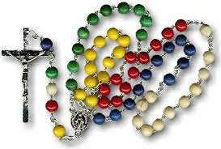
Amai athu a Paulendo, Amai a ophunzira a Khristu ndiponso Mfumukazi ya mtendere, mutipempherere ife!
Kolona wa Utumiki
Zikomo kwambiri nonse

